Slide 1




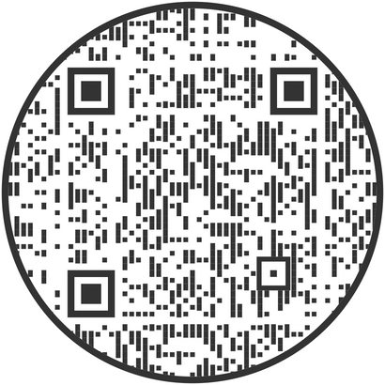
February 22, 2024
11 AM - 1:30 PM
Snyder MBC
701 Westmont Dr.
TO PURCHASE TICKETS:
BIT.LY/BNB2024
OR SCAN HERE:
Proceeds benefit the ministry of
Fayetteville Area Operation Inasmuch
Free Delivery on 10 or More Orders!

